Slide 1

SREENIVASA INSTITUTE OF TECHNOLOGY AND MANAGEMENT STUDIES (AUTONOMOUS)
CROP PREDICTION USING SUPERVISED
ML TECHNIQUE
GUIDED BY: PRESENTED BY:
M.PUSHPANJALI G.M.SANDEEP- 19751A0522
C.GIRI- 19751A0517
J.GOWTHAM- 19751A0536
M.GUNADEEP- 19751A0561

Slide 2
Introduction
Agriculture provides most of the world's food and fabrics. Cotton, wool, and leather are all agricultural products.
Agriculture also provides wood for construction and paper products. These products, as well as the agricultural methods used, may vary from one part of the world to another.
In general, agriculture is the backbone of India and also plays an important role in the Indian economy.
Now-a-days, food production and prediction are getting scarcity due to unnatural climatic changes, which will adversely affect the economy of farmers by getting a poor yield and also help the farmers to remain less familiar with forecasting the future crops.

Slide 3
Abstract
This research work helps the beginner farmer in such a way to guide them for reasonable crops by deploying machine learning, one of the advanced technologies in crop prediction.
Supervised machine learning algorithm puts in the way to achieve it.
The seed data of the crops are collected here, with the appropriate parameters like nitrogen, phosphorus, temperature, humidity, pH and rainfall content, which helps the crops to achieve successful growth.
To prevent this problem, Agricultural sectors have to predict the crop from a given dataset using machine learning techniques.
Also we are calculating the performance metrics.

Slide 4
Literature Review
Title : Plant Yield Prediction Model Using Firefly based Feature Selection with Modified Fuzzy Cognitive Maps
Author: D. Sabareeswaran, R. Gunasundari
Year : 2018
Among worldwide, agriculture has the major responsibility for improving the economic contribution of the nation. However, still the most agricultural fields are under developed due to the lack of deployment of ecosystem control technologies. Due to such issue 6, the crop production is not improved which affects the agriculture economy. Hence in this paper, a development of agricultural productivity is enhanced based on the plant yield prediction. Initially, different features such as plant images, soil characteristics, and weather factors are gathered and Firefly (FF) optimization algorithm is proposed for Feature Selection (FFFS). Then, the most selected optimal features are classified based on the Modified Fuzzy Cognitive Map (MFCM) algorithm for predicting the growth of plant yield. The predicted outcome is transmitted to the farmer’s through smart phones which helps for identifying the growth of plant and improving the harvesting. The experimental results show that the effectiveness of the proposed technique can be compared with the other prediction techniques.

Slide 5
Existing System
Active MicrowaveOven remote seeing data at different frequentness can give pivotal information on crop morphology and conditions, therefore effectively supporting agronomic operation at different scales.
Despite the ever- adding vacuity of space borne platforms and the expansive exploration developed throughout further than two decades, some knowledge gaps still await to be filled toward functional use, dealing with SAR backscatter response to crop-specific features and seasonal dynamics, including the goods of agronomic practices.
In this work, we used friction- grounded global perceptivity analysis( GSA) as a quantitative frame for probing the perceptivity ofX-band backscattering to agronomic and morphological features typical of two different crops sludge and rice.
To this end, we concertedly exploited empirical data on crop status and growth, high- resolution TerraSAR- X( TSX) data, and microwave oven radiative transfer model( RTM) simulations.

Slide 6
Proposed System
The proposed system will predict the most suitable crop for particular land based on soil contents and weather parameters such as Temperature, Humidity, Soil PH, Nitrogen, Phosphorus, and Rainfall.
Data collection is the most efficient method for collecting and measuring data from different resources.
Statistical algorithms and machine learning techniques to identify future outcomes based on historical data.
The goal is to go beyond knowing what has happened to provide the best assessment of what will happen in the future.
In our system, we used a supervised machine learning algorithm having subcategories as classification and regression. The classification algorithm will be most suitable for our system.

Slide 7
Environmental Requirements
Software Requirements:
Operating System : Windows 10 or later
Tool : Anaconda with Jupyter Notebook
Hardware requirements:
Processor : Intel i3
Hard disk : minimum 10 GB
RAM : minimum 4 GB

Slide 8
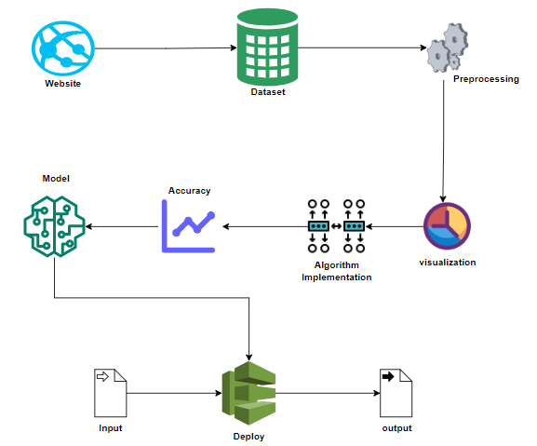
System Architecture

Slide 9
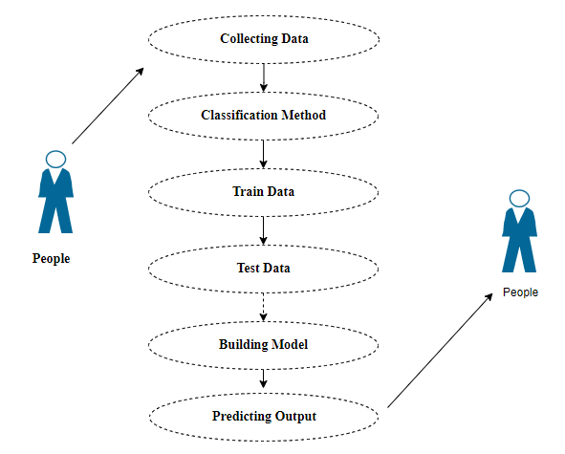
Use Case Diagram:

Slide 10
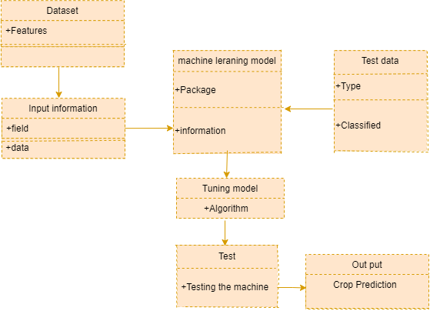
Class Diagram:

Slide 11
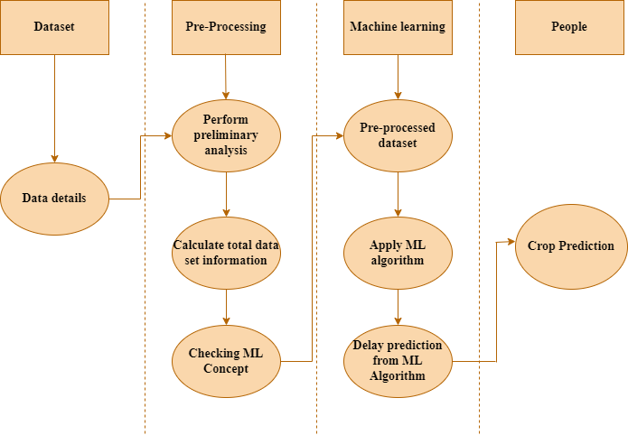
Activity Diagram:

Slide 12
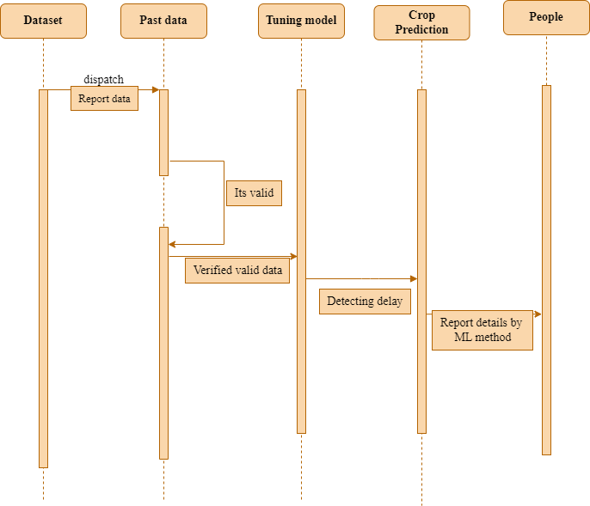
Sequence Diagram:

Slide 13
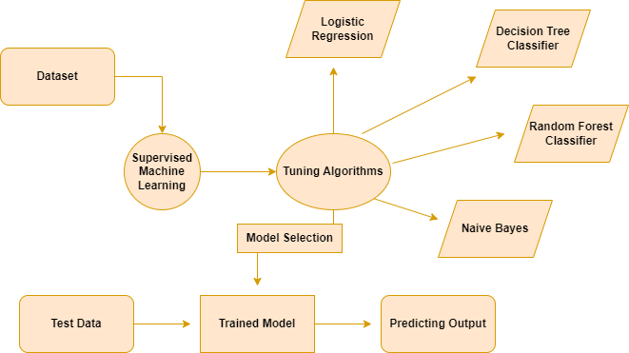
Entity Relationship Diagram (ERD):

Slide 14
List of Modules
Data Pre-processing
Data Analysis of Visualization
Implementing Logistic Regression
Implementing Gaussian Naïve Bayes
Implementing Decision Tree Classifier
Implementing Random Forest Classifier
Deployment

Slide 15
Module Description
Data Pre-processing:
Validation techniques in machine learning are used to get the error rate of the Machine Learning (ML) model, which can be considered as close to the true error rate of the dataset.
If the data volume is large enough to be representative of the population, you may not need the validation techniques. However, in real-world scenarios, to work with samples of data that may not be a true representative of the population of given dataset.
To finding the missing value, duplicate value and description of data type whether it is float variable or integer. The sample of data used to provide an unbiased evaluation of a model fit on the training dataset while tuning model hyper parameters.

Slide 16
Data Visualization:
Data visualization is an important skill in applied statistics and machine learning.
Statistics does indeed focus on quantitative descriptions and estimations of data.
Data visualization provides an important suite of tools for gaining a qualitative understanding.
This can be helpful when exploring and getting to know a dataset and can help with identifying patterns, corrupt data, outliers, and much more.

Slide 17
Naive Bayes Theorem:
Naive Bayes classifiers are a collection of classification algorithms based on Bayes’ Theorem.
It is not a single algorithm but a family of algorithms where all of them share a common principle, i.e. every pair of features being classified is independent of each other.
The assumptions made by Naive Bayes are not generally correct in real-world situations. In-fact, the independence assumption is never correct but often works well in practice.

Slide 18
Logistic Regression:
Logistic regression is a supervised learning algorithm used to predict a dependent categorical target variable.
In essence, if you have a large set of data that you want to categorize, logistic regression may be able to help.
For example, if you were given a dog and an orange and you wanted to find out whether each of these items was an animal or not, the desired result would be for the dog to end up classified as an animal, and for the orange to be categorized as not an animal.
Animal is your target; it is dependent on your data in order to be able to classify the item correctly.

Slide 19
Decision Tree Classifier:
It is one of the most powerful and popular algorithm. Decision-tree algorithm falls under the category of supervised learning algorithms.
It works for both continuous as well as categorical output variables.
Decision tree builds classification or regression models in the form of a tree structure
It breaks down a data set into smaller and smaller subsets while at the same time an associated decision tree is incrementally developed.
A decision node has two or more branches and a leaf node represents a classification or decision.

Slide 20
Random Forest Classifier:
Random forests or random decision forests are an ensemble learning method for classification, regression and other tasks, that operate by constructing a multitude of decision trees at training time and outputting the class that is the mode of the classes (classification) or mean prediction (regression) of the individual trees.
Random decision forests correct for decision trees’ habit of over fitting to their training set. Random forest is a type of supervised machine learning algorithm based on ensemble learning.
Ensemble learning is a type of learning where you join different types of algorithms or same algorithm multiple times to form a more powerful prediction model. The random forest algorithm combines multiple algorithm of the same type i.e. multiple decision trees, resulting in a forest of trees, hence the name "Random Forest".
The random forest algorithm can be used for both regression and classification tasks.

Slide 21
Deployment:
Flask is a micro web framework written in Python.
It is classified as a micro-framework because it does not require particular tools or libraries.
It has no database abstraction layer, form validation, or any other components where pre-existing third-party libraries provide common functions.
However, Flask supports extensions that can add application features as if they were implemented in Flask itself.

Slide 22
Conclusion
The analytical process started from data cleaning and processing, missing value, exploratory analysis and finally model building and evaluation.
The best accuracy on crop cultivation set of higher accuracy score algorithm will be find out.
The founded one is used in the application which can help to know which crop cultivate here with high yield.

Slide 23
References
Crop Yield Prediction Using Machine Learning: A Review, by Nitish Kumar Sharma, et al. (2019).
Predicting crop yield with deep learning, by Andrew Ng, et al. (2018).
Crop yield prediction using remote sensing and machine learning, by Jiali Shang, et al. (2017).
Crop yield prediction using satellite remote sensing data: A review, by Hailong Zhang, et al. (2021).
Deep Learning-Based Crop Yield Prediction Using Remote Sensing Data: A Review and Meta-Analysis, by Muhammad Arsalan, et al. (2021).

